Slide 1
Deep Learning with PyTorch
Seth Juarez
@sethjuarez

Slide 2
Agenda
Machine Learning is Different
Data is the Key
Tensors, Datasets, and DataLoaders
Crafting a Model
Model
Making the Model Better
Loss/Cost, Optimization
Using a Model
Save/Load/Use

Slide 3
Machine Learning…

Slide 4

programming
algorithm
answers
input

Slide 5
machine learning
answers
algorithm
input

Slide 6

machine learning
PyTorch
model
data

Slide 7

machine learning
data
PyTorch
model / algorithm
code
answers
input

Slide 8
Data is Key
Computer Vision – three easy examples

Slide 9
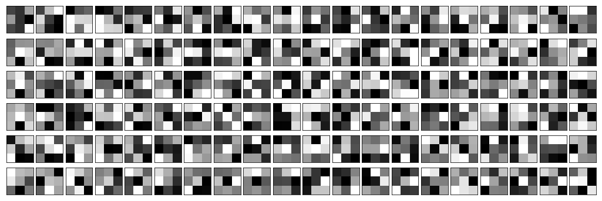

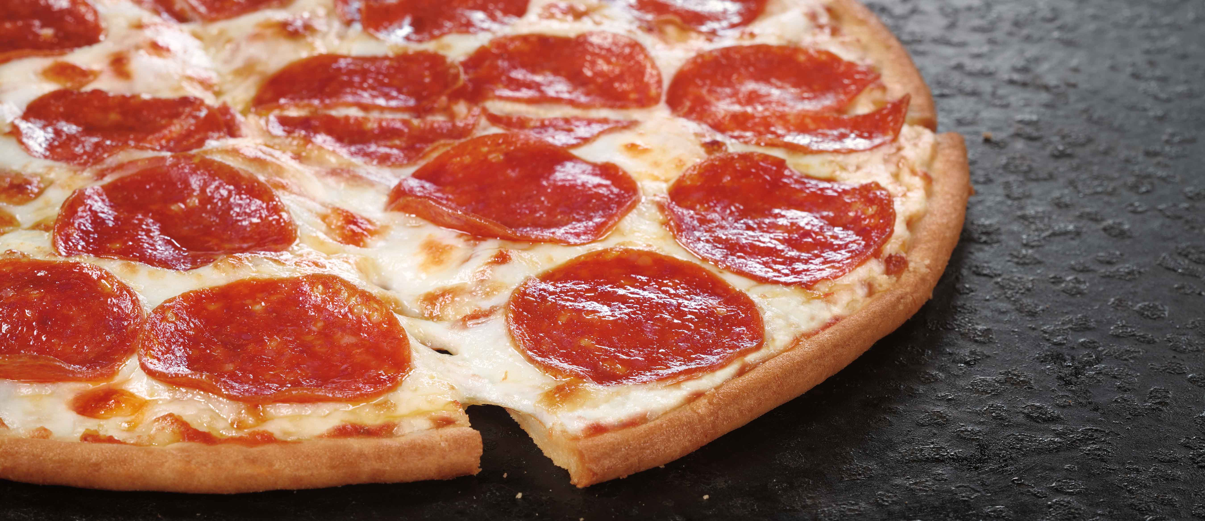
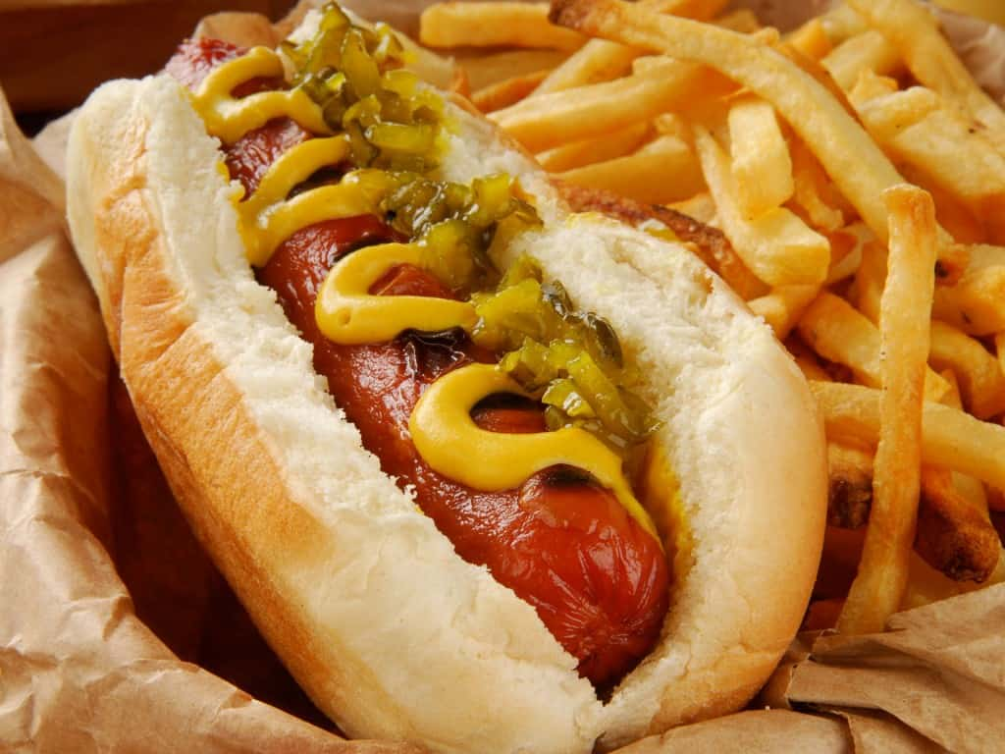

Slide 10
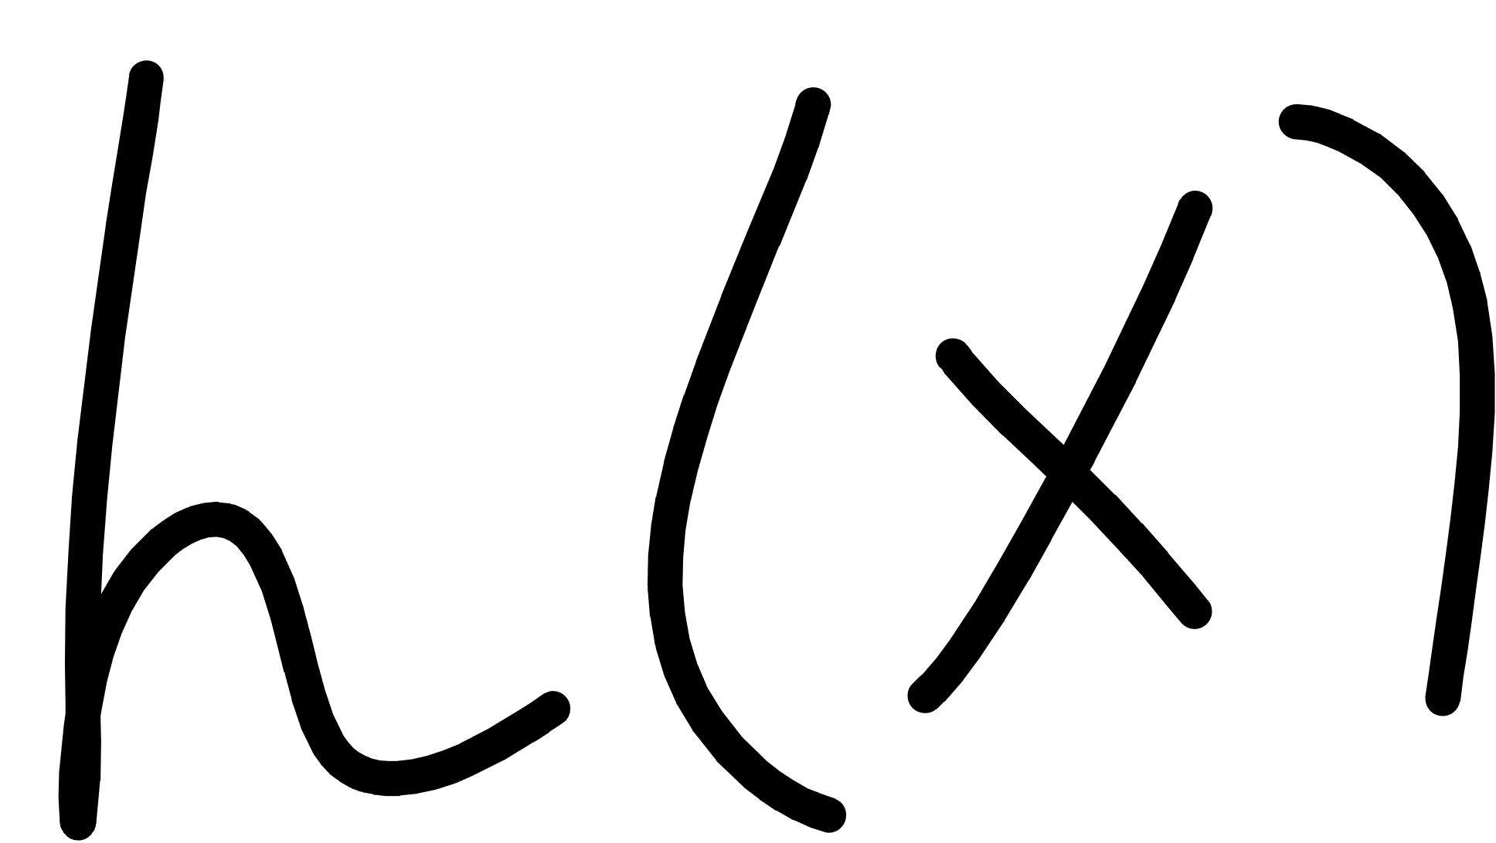
Notes:
Cover the fact that ML uses data to make its own functions

Slide 11
Notes:
Cover the fact that ML uses data to make its own functions

Slide 12
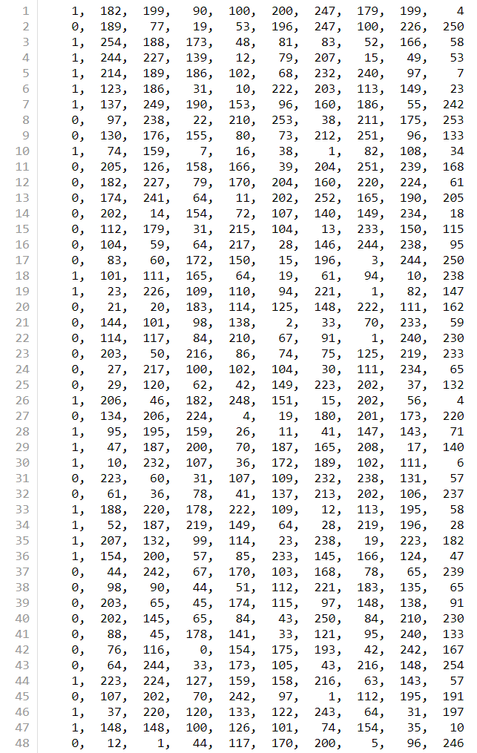


Slide 13
Tensors, Dataset, DataLoader
tensors.ipynb, data.ipynb

Slide 14
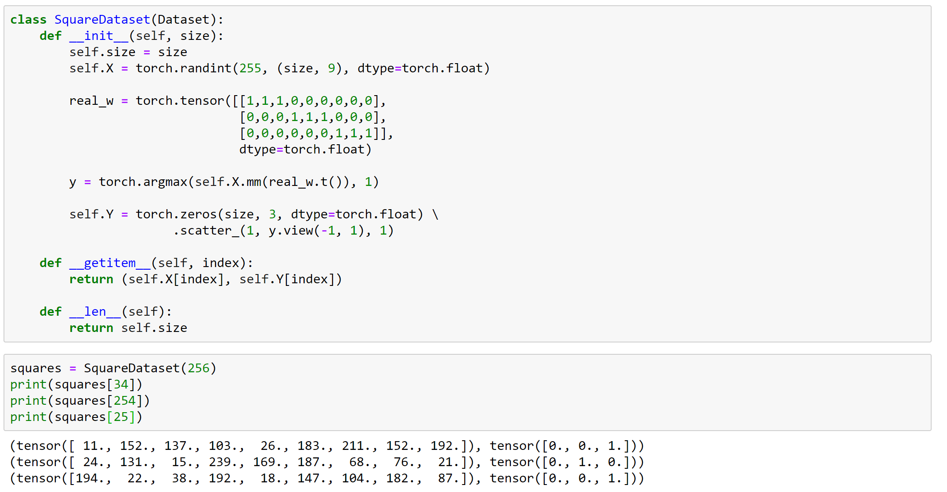

Slide 15
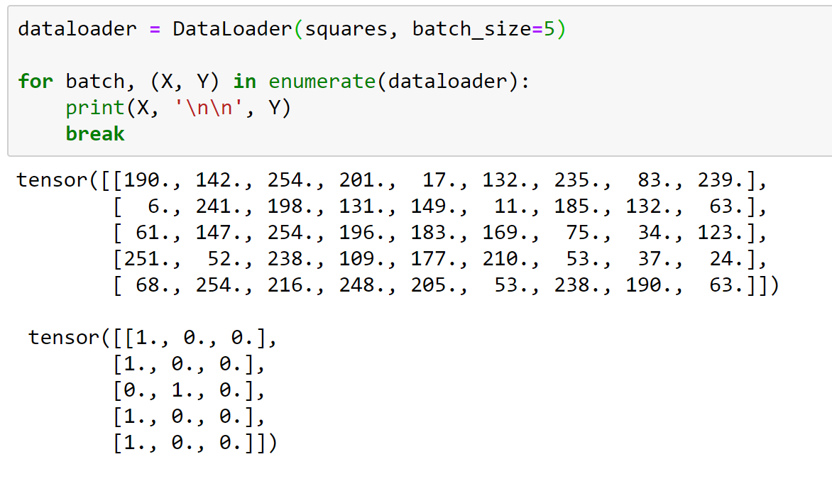

Slide 16
Creating a Model
“Machine Learning is a lazy way of writing a Function” - Dr. Inttr Nette

Slide 17
Notes:
Cover the fact that ML uses data to make its own functions

Slide 18
Notes:
Cover the fact that ML uses data to make its own functions

Slide 20
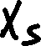
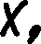
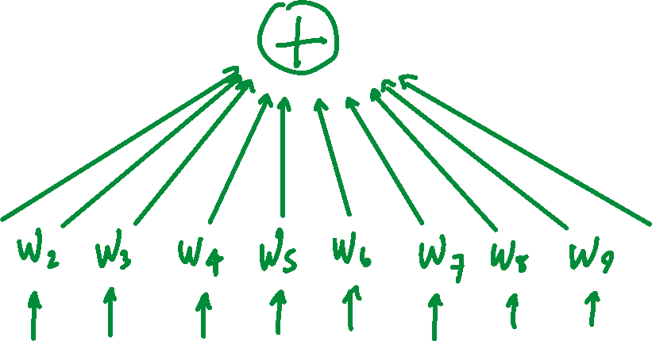
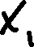

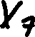

Slide 21
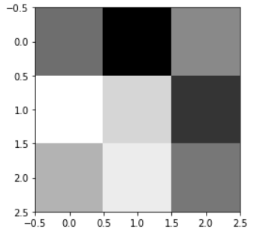
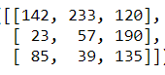
[142, 233, 120, 23, 57, 190, 85, 39, 135]

Slide 22
[ 1, 1, 1, 0, 0, 0, -1, -1, -1]
[142, 233, 120, 23, 57, 190, 85, 39, 135]
236

Slide 23
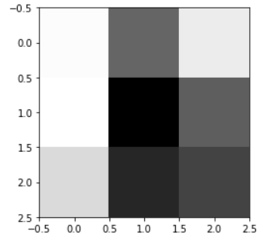
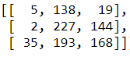
[5, 138, 19, 2, 227, 144, 35, 193, 168]

Slide 24
[ 1, 1, 1, 0, 0, 0, -1, -1, -1]
[5, 138, 19, 2, 227, 144, 35, 193, 168]
-234

Slide 25
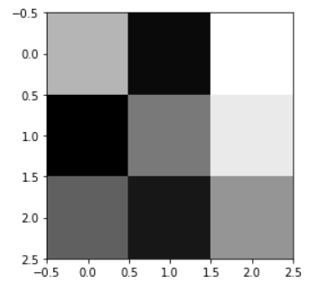









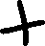

Slide 26






Slide 27



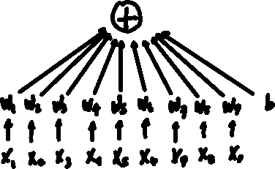

top
middle
bottom

Slide 28
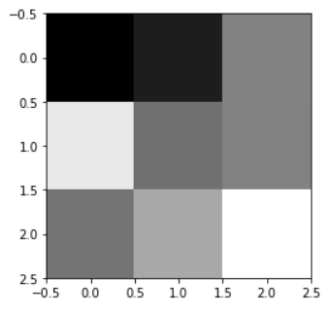
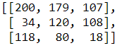




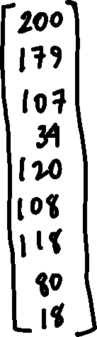


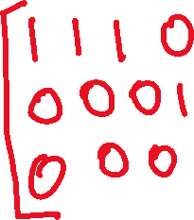
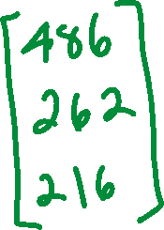

Slide 29






Slide 30
Constructing Models in PyTorch
squares.ipynb

Slide 31
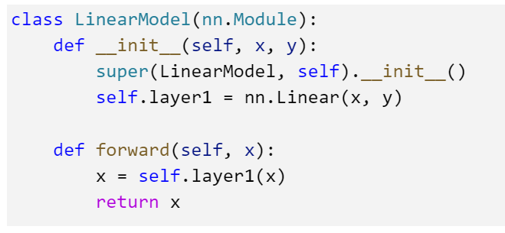
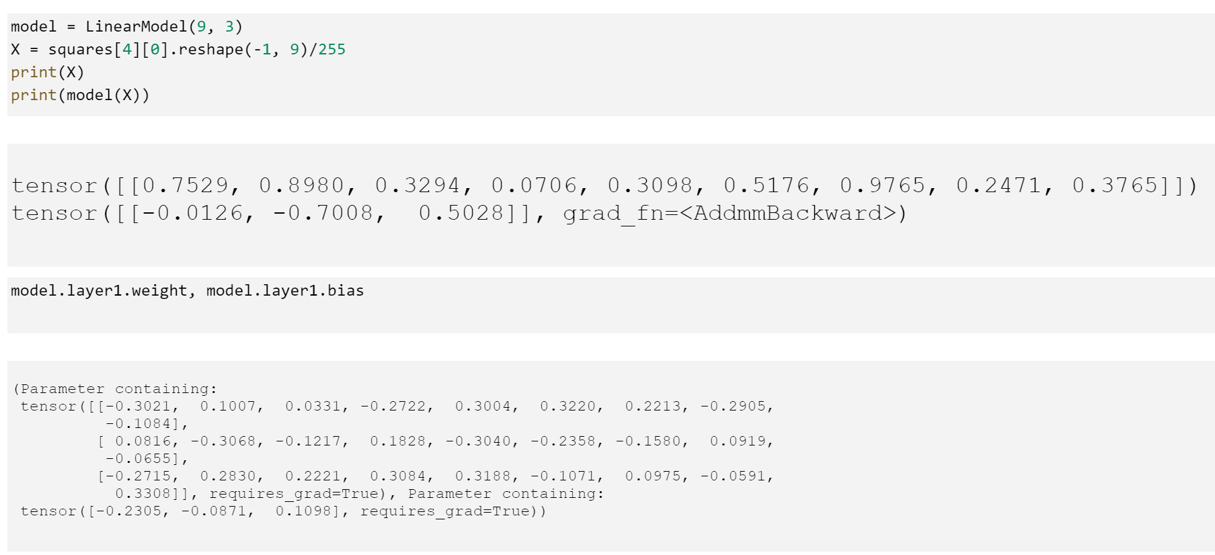

Slide 32
Making the Model Better
“Sometimes Math is ok if we use it right…”
- Dr. Inttr Nette

Slide 33












Slide 34










Slide 36









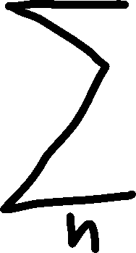



Slide 37
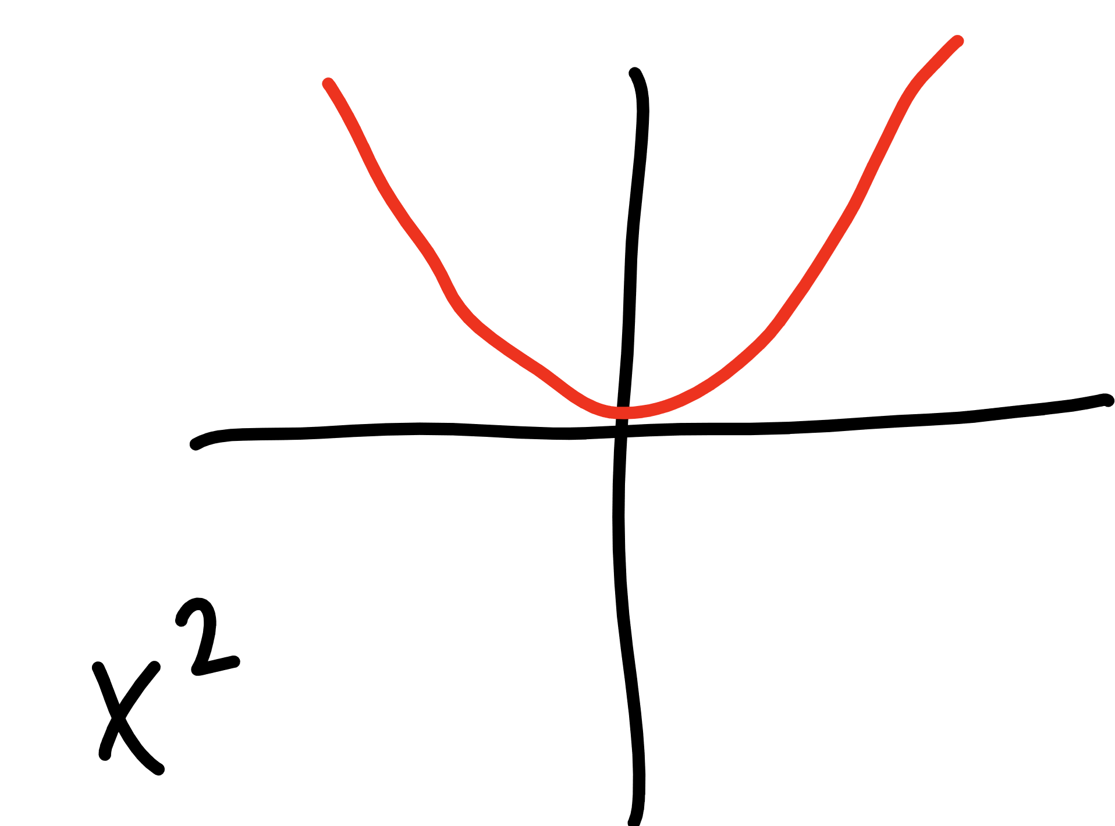
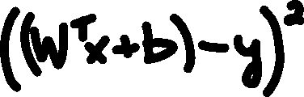

Slide 38



Slide 39



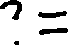
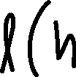
Making the Model Better
model – the function shape we construct
cost/loss function – a function that tells us how bad we are at predicting
optimizer – method for reducing how bad we are at predicting

Slide 40
PyTorch Tensors are… special
“It’s True!”
- Smartte Gai
graph.ipynb

Slide 41
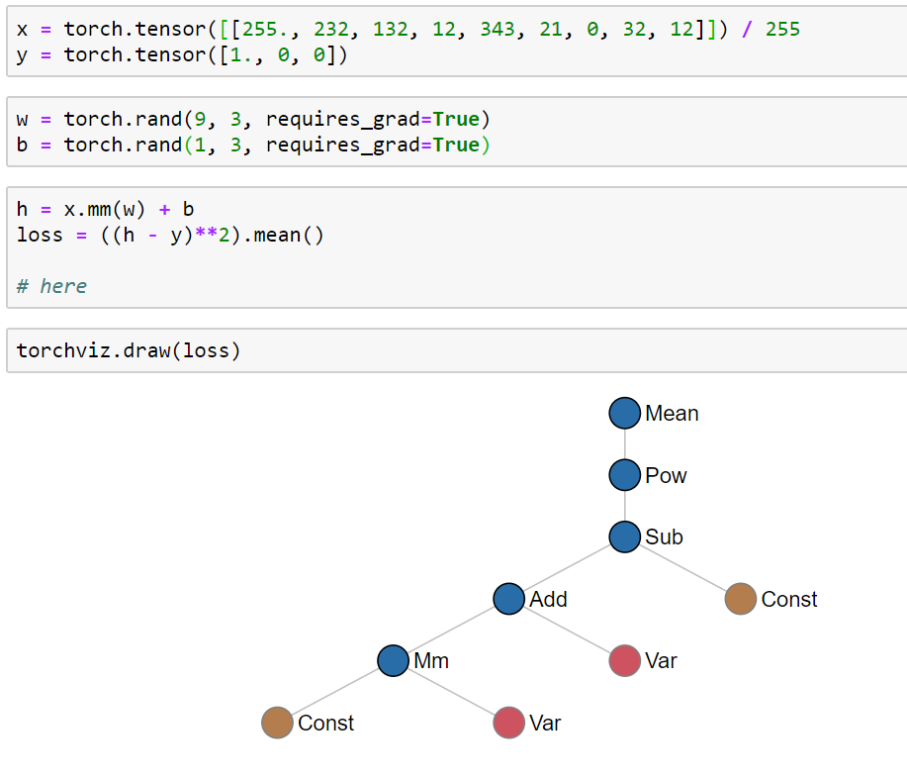

Slide 42
Putting it all together
THE LOOP!

Slide 43
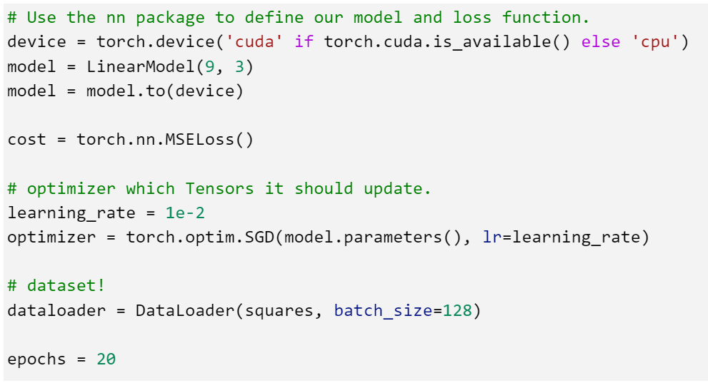
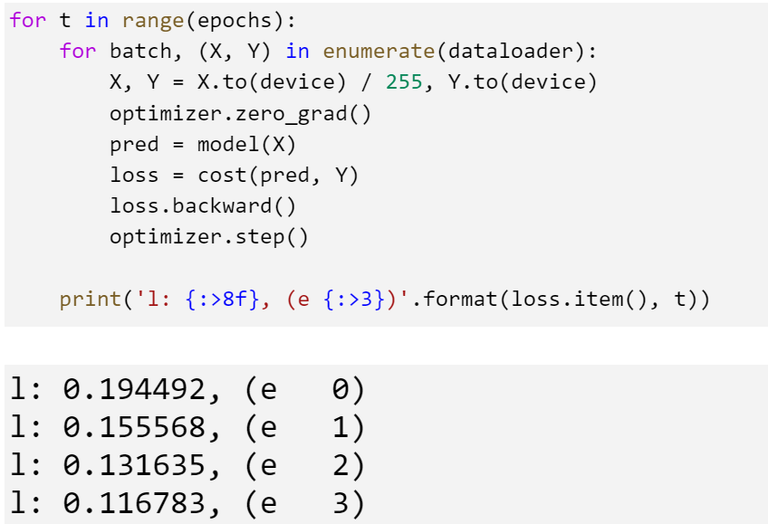

Slide 44
Using the Model
squares.ipynb

Slide 45
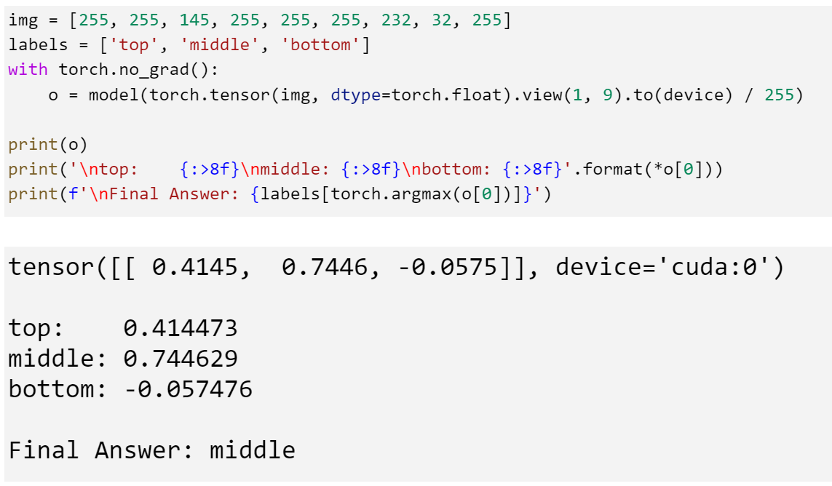

Slide 46
Review
Machine Learning is Different
Data is the Key
Tensors, Datasets, and DataLoaders
Crafting a Model
Model
Making the Model Better
Loss/Cost, Optimization
Using a Model
Save/Load/Use

Slide 47
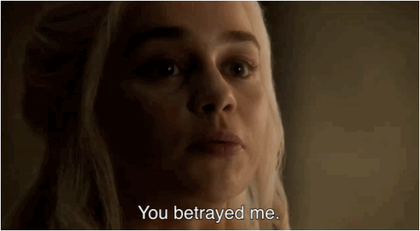

Slide 48


Slide 49
Digits tho…

Slide 51






Slide 52
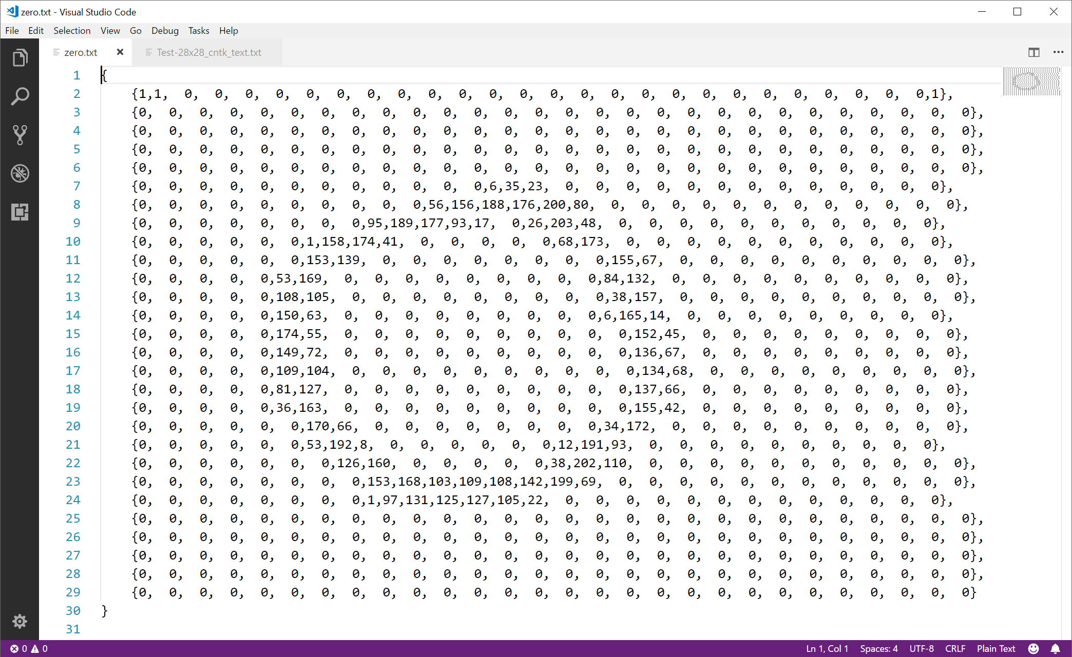

Slide 53
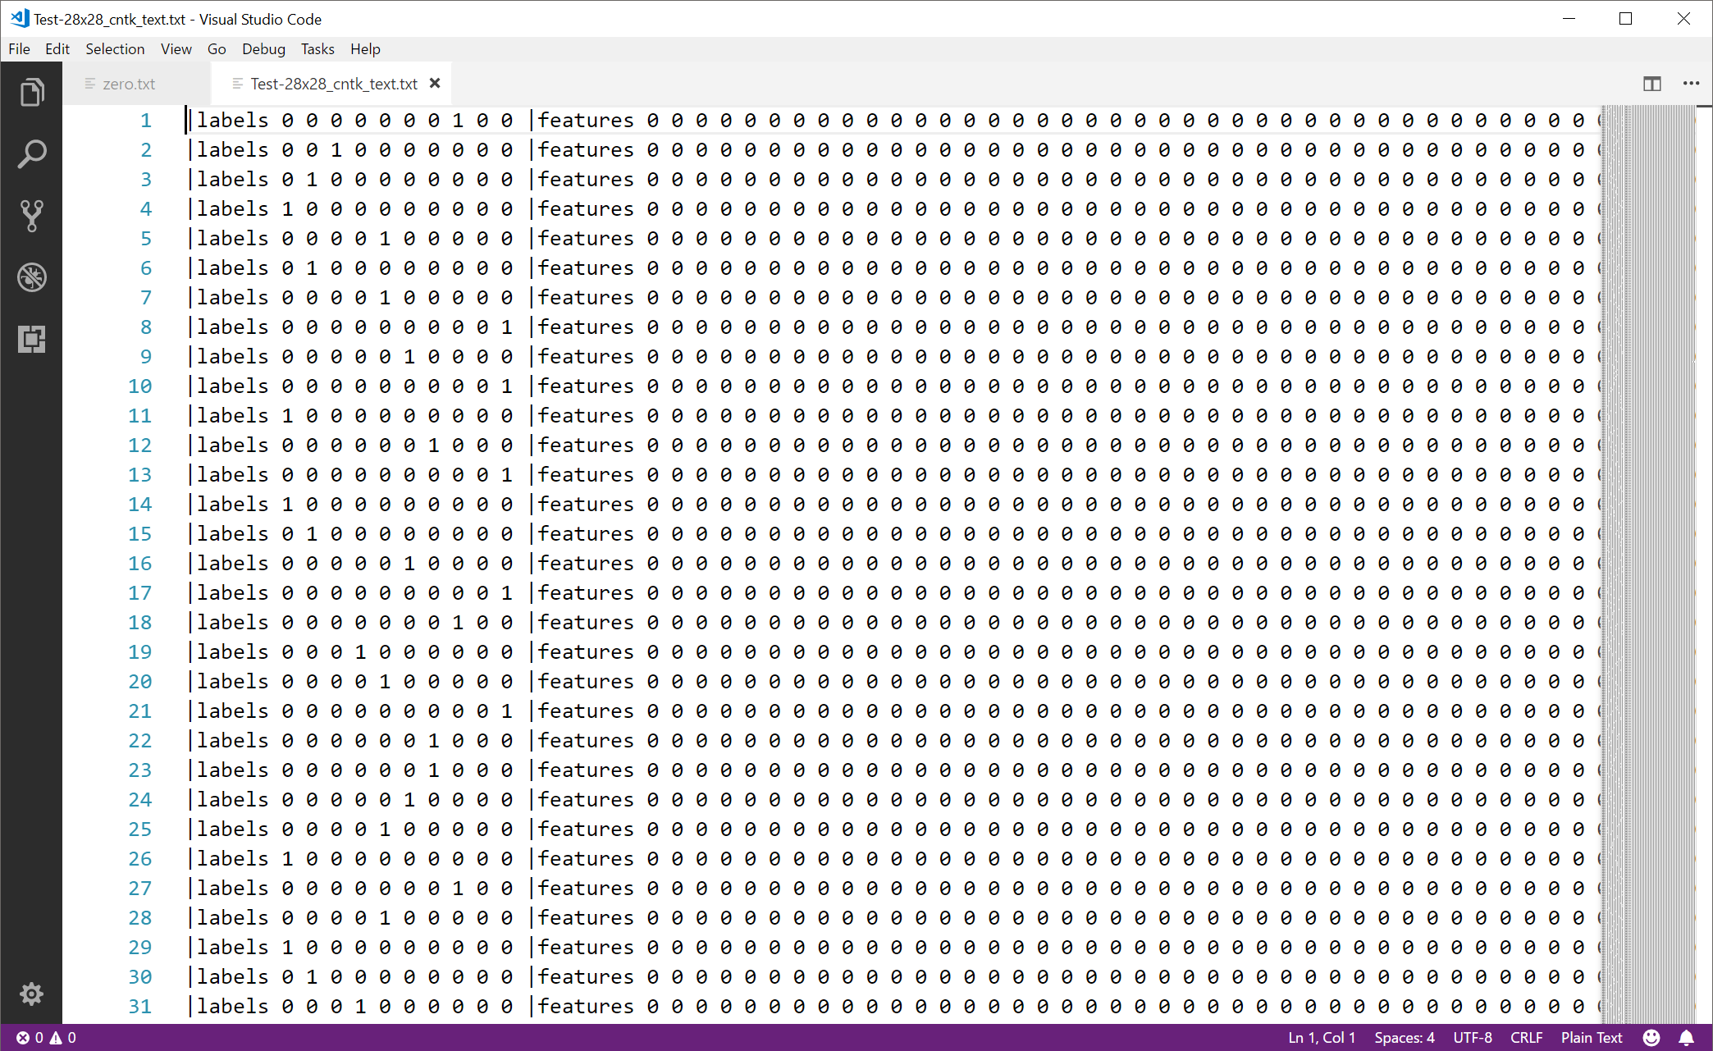

Slide 55
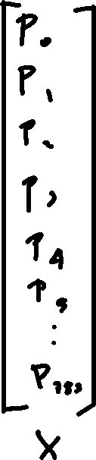
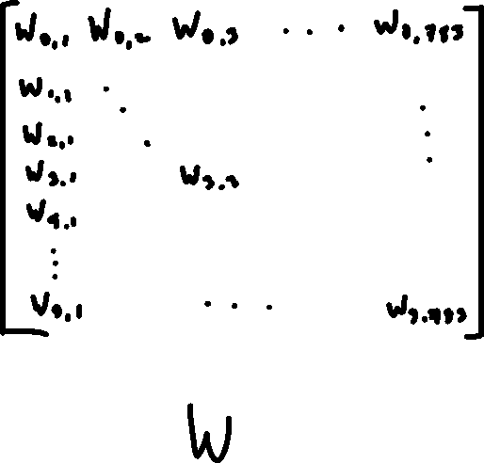
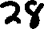


Slide 56


Slide 57
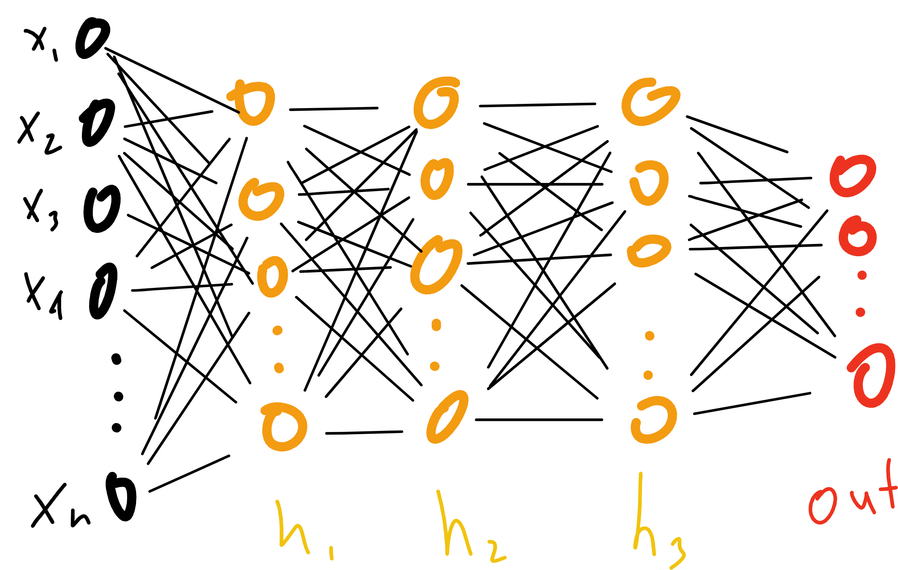

Slide 58
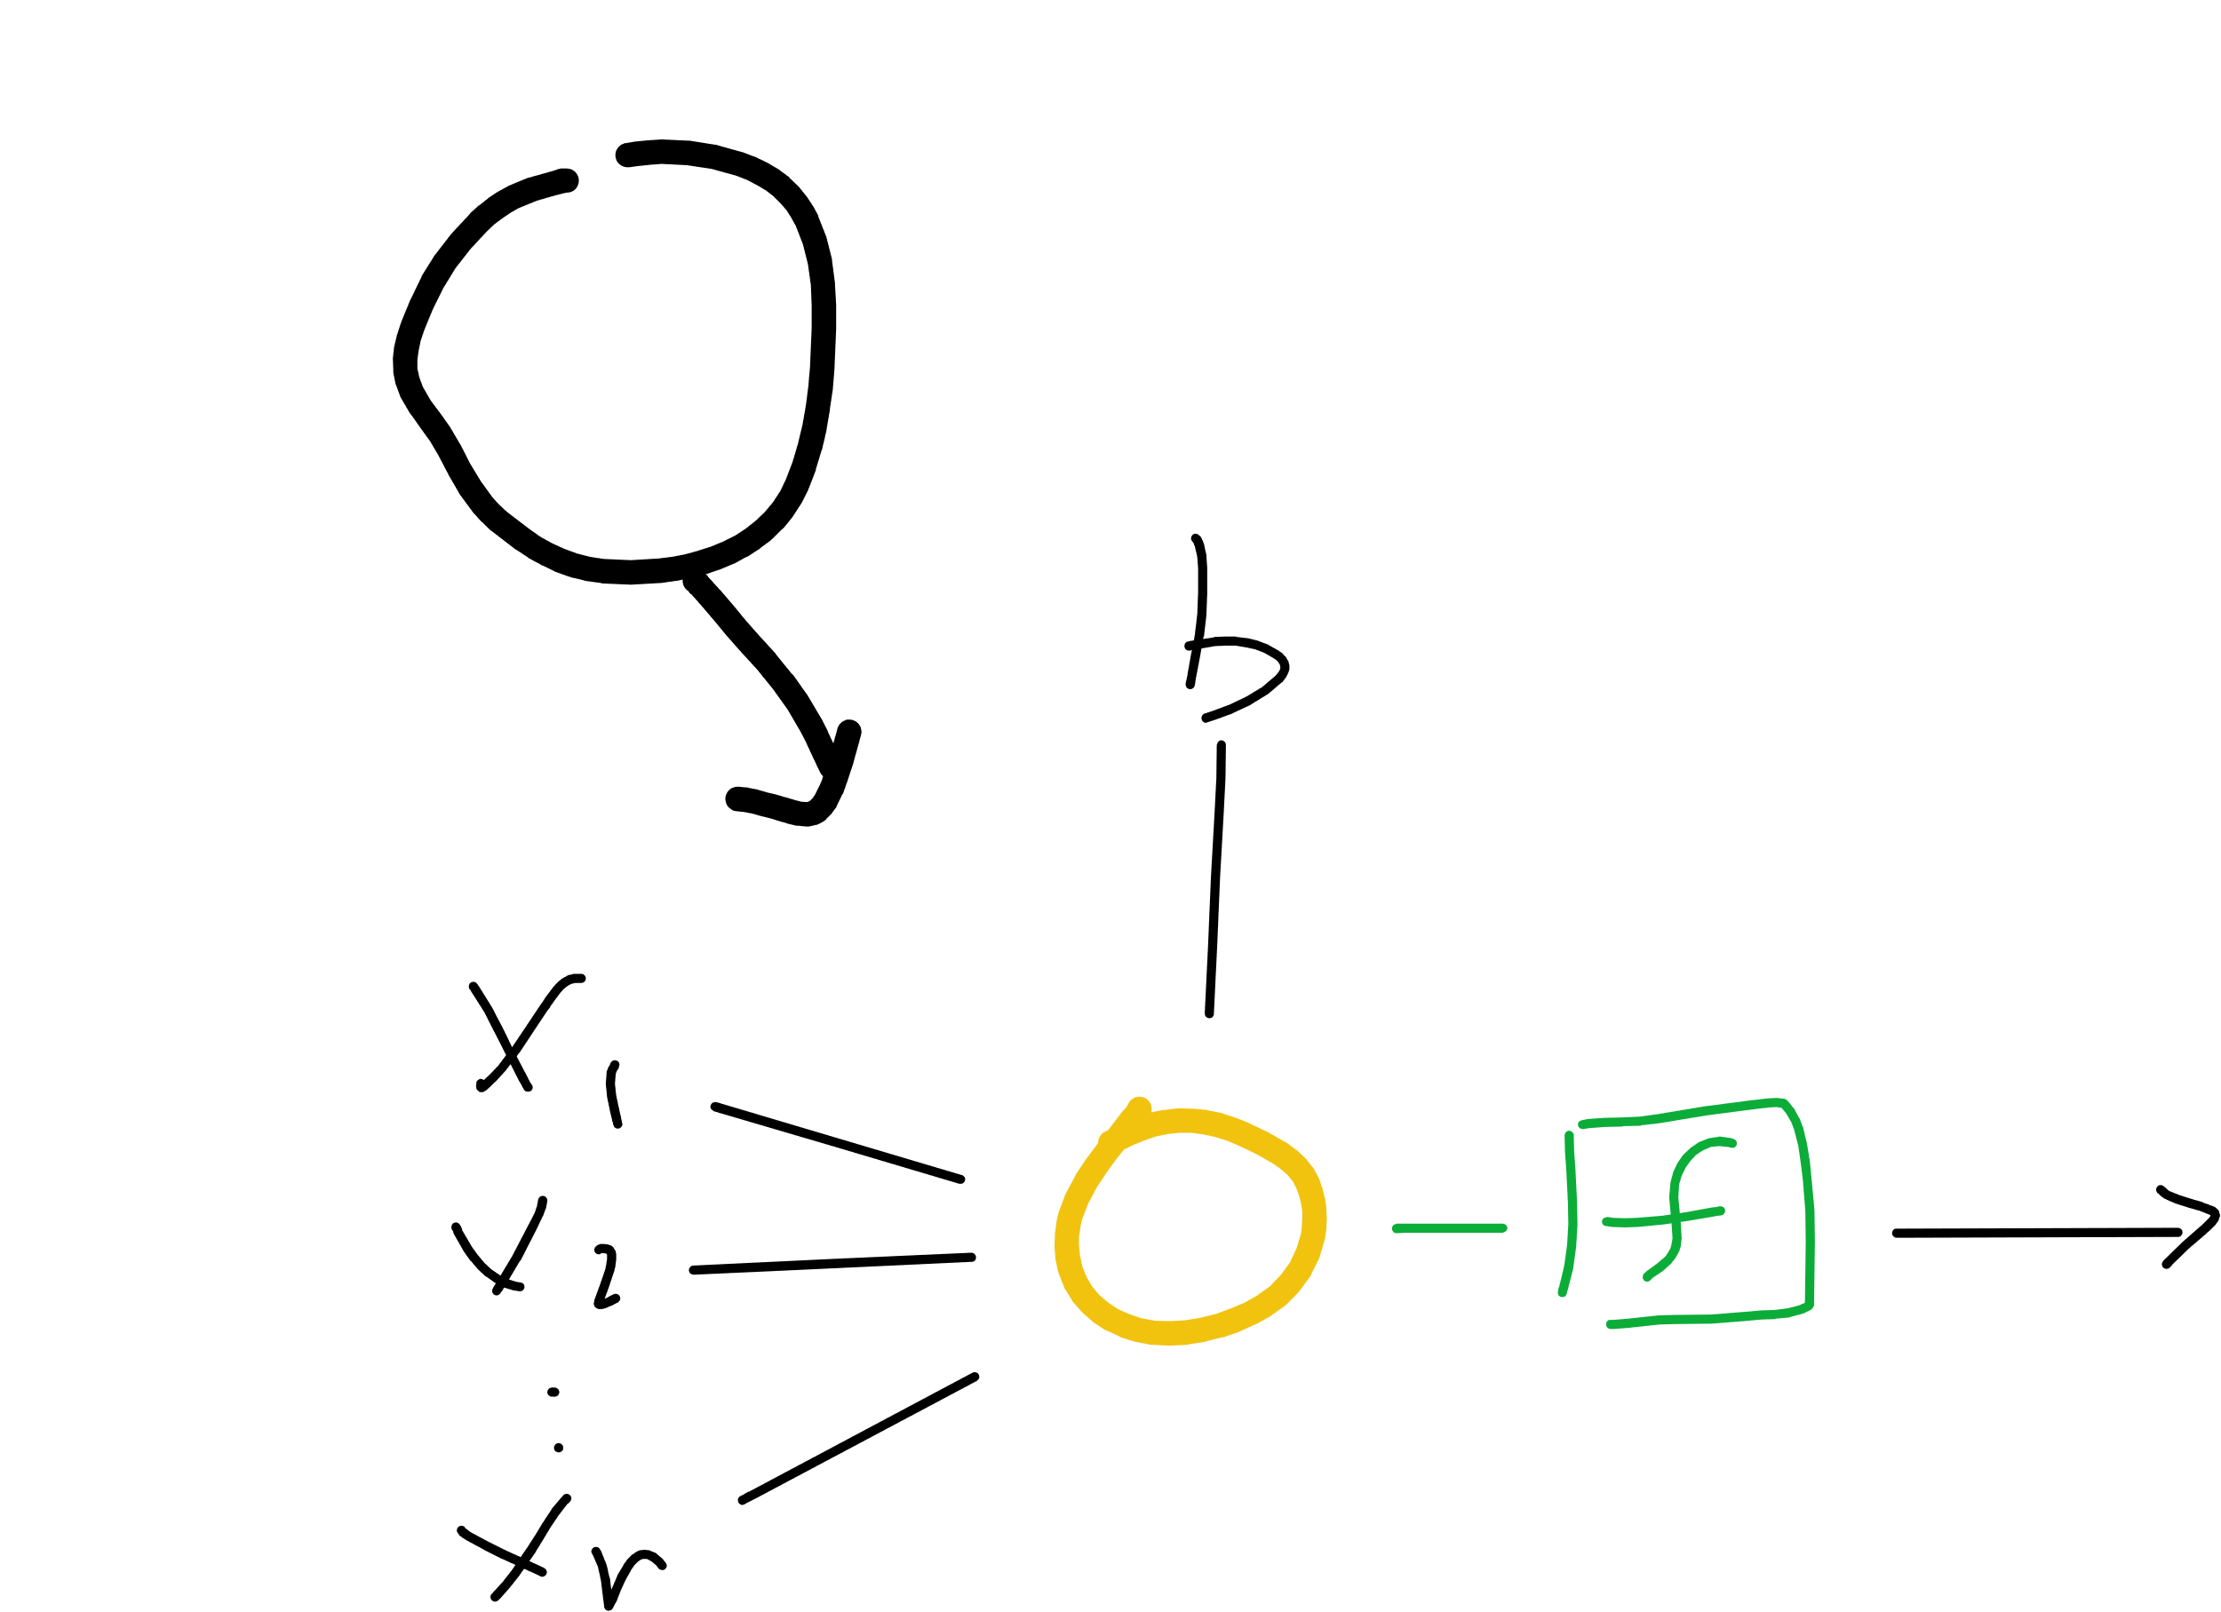
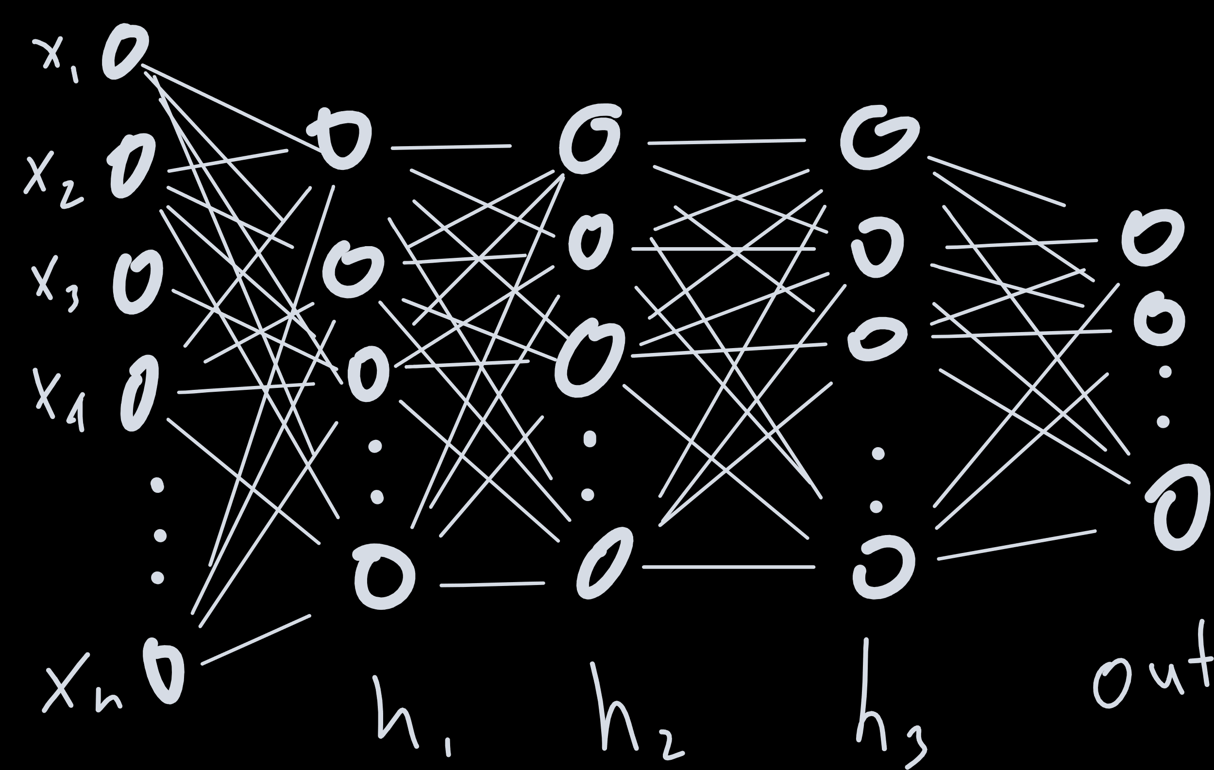
Notes:
Proof by induction

Slide 59
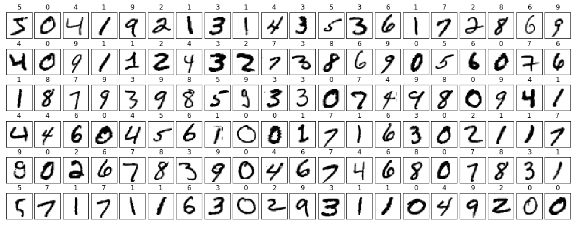
Notes:
Derivative?
Architecture

Slide 60
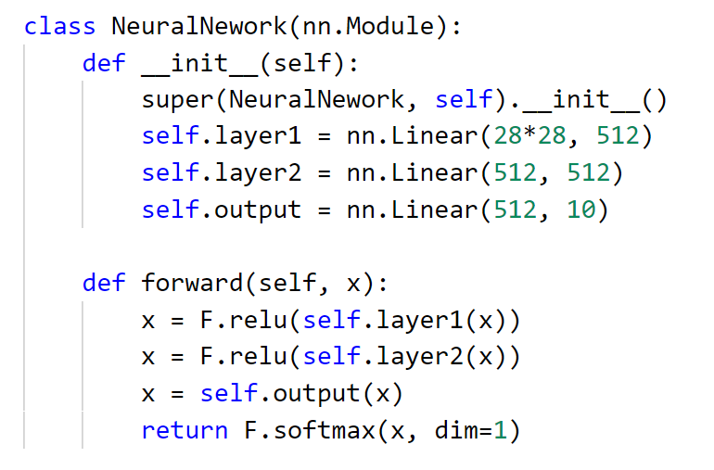

Slide 61
Better Network…

Slide 62
filters and pooling

Slide 63
filters
2 | 4 | 9 | 1
6 | 3 | 5 | 7
2 | 8 | 2 | 4
9 | 7 | 3 | 6
1 | 1 | 1
0 | 0 | 0
-1 | -1 | -1
3 | 0
-5 | -1

Slide 64
padding
0 | 0 | 0 | 0 | 0 | 0
0 | 2 | 4 | 9 | 1 | 0
0 | 6 | 3 | 5 | 7 | 0
0 | 2 | 8 | 2 | 4 | 0
0 | 9 | 7 | 3 | 6 | 0
0 | 0 | 0 | 0 | 0 | 0
-9 | -14 | -15 | -12
-4 | 3 | 0 | 7
-7 | -5 | -1 | 3
10 | 12 | 14 | 6
1 | 1 | 1
0 | 0 | 0
-1 | -1 | -1

Slide 65
pooling
-9 | -14 | -15 | -12
-4 | 3 | 0 | 7
-7 | -5 | -1 | 3
10 | 12 | 14 | 6
3 | 7
12 | 14

Slide 66
Notes:
Derivative?
Architecture

Slide 67
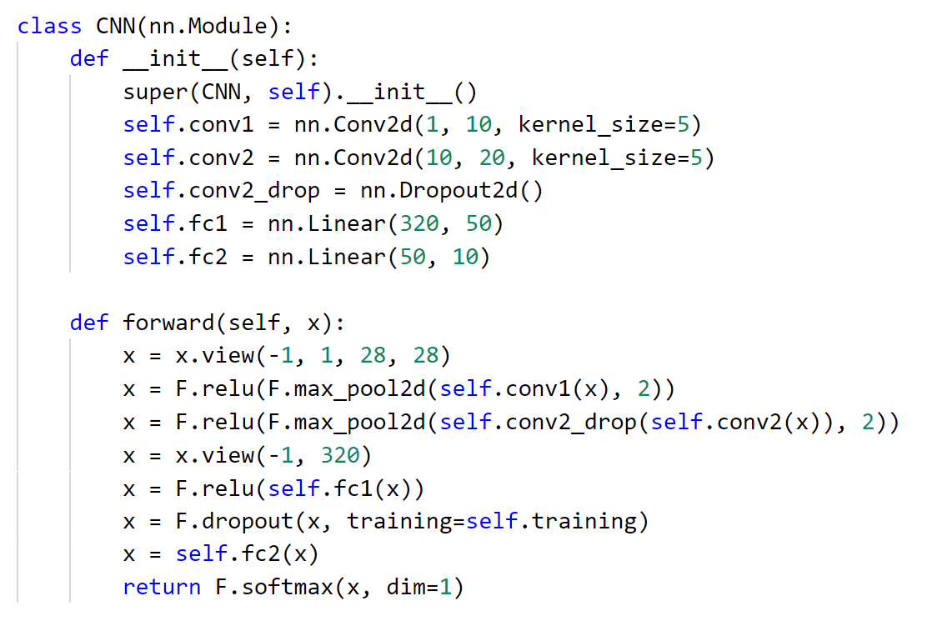

Slide 68
Putting it all together
a full run through to production

Slide 69
Review
Machine Learning is Different
Data is the Key
Tensors, Datasets, and DataLoaders
Crafting a Model
Model
Making the Model Better
Loss/Cost, Optimization
Using a Model
Save/Load/Use

Slide 70

Seth Juarez
Microsoft
@sethjuarez

